Slide 1
Introduction to
for Khmer developer
Docker
Borey | July 3, 2022
online

Slide 2
a little about me
Understand docker
build and run docker image
share your docker image
running application with docker-compose
deploy docker app to the cloud
Agenda
Docker
Borey | July 3, 2022
online

Slide 3
bachelor degree in computer science from Washington state university
senior software engineer in u.s.a
sharing some knowledge on various topics with khmer developers
docker for now
1- About Me
Docker
Borey | July 3, 2022
online

Slide 4
Portability: package app and run anywhere -> containerized app
rapid app development: minimal runtime, small size
sharing: remote repo, tar file
lightweight: small footprint, minimal overhead
Simplified maintenance: reduce risk of app dependency issue
2- Understand Docker
Benefits
Docker vs Container
docker is a container technology (Podman, freebsd etc)
docker make container popular
Docker
Borey | July 3, 2022
online

Slide 5
2- Understand Docker
More about Container
Docker
Borey | July 3, 2022
online

Slide 6
2- Understand Docker
More about Container
Container image become containers
Containers share OS Kernel
Isolated processes in user space
Docker
Borey | July 3, 2022
online

Slide 7

3- Build and Run Docker image
Run a docker image
docker run -it --rm --name myubuntu ubuntu:20.04 /bin/bash
-it => run the container in interactive mode
-rm => automatically remove the container after exit
—name => give a name to that container
ubuntu:20.04 => remote docker image to run
/bin/bash => start bash shell
More command lines visit: https://docs.docker.com/engine/reference/commandline/cli/
Docker
Borey | July 3, 2022
online

Slide 8

3- Build and Run Docker image
Run a docker image in background
docker run -d -p 80:80 --name mywebapp nginx:1.17-alpine
-d => run the container in detached mode
-p 80:80 => map port 80 of the host to port 80 in the container
nginx:1.17-alpine => remote container image to run
docker ps
docker stop mywebapp
docker start mywebapp
Docker
Borey | July 3, 2022
online

Slide 9

3- Build and Run Docker image
Build a new docker image and run it
docker build -t myapp .
docker run -d --name myapp-runner myapp:latest
docker ps
docker stop myapp-runner
docker start myapp-runner
docker run -d -p 8080:3000 --rm --name myapp-runner myapp:latest
docker exec -it myapp-runner sh
Docker
Borey | July 3, 2022
online

Slide 10
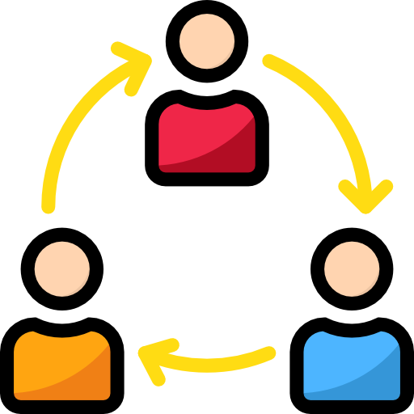
4- Sharing Docker image
Share your docker image to repository
Create an account at https://hub.docker.com
docker login
docker tag myapp borey/myapp
docker push borey/myapp
Docker
Borey | July 3, 2022
online

Slide 11
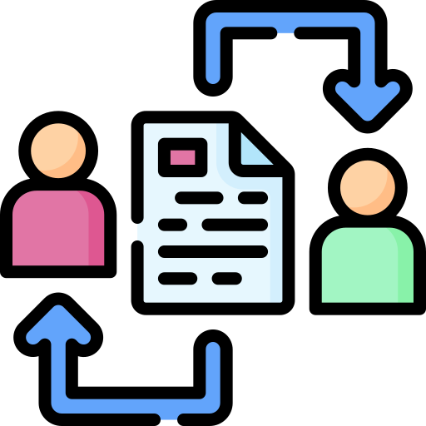
4- Sharing Docker image
Share your docker image using tar file
docker save --output myapp.tar myapp
docker load --input myapp.tar
docker run -it -p 8080:3000 --rm --name myapp-runner myapp
Docker
Borey | July 3, 2022
online

Slide 12

5- running application with docker-compose
Docker-compose build
Docker-compose up
Docker-compose down
Docker
Borey | July 3, 2022
online

Slide 13
6- Deploy Docker App to the cloud
Google Cloud Run
https://cloud.google.com/run/docs/quickstarts/deploy-container
Azure Container App
https://azure.microsoft.com/en-us/services/container-apps
Aws App Runner
https://aws.amazon.com/apprunner/
Docker
Borey | July 3, 2022
online

